Slide 1
CS 4530: Fundamentals of Software Engineering Module 10: Application-Level Patterns
Adeel Bhutta, Joydeep Mitra and Mitch Wand
Khoury College of Computer Sciences
© 2025 Released under the CC BY-SA license

Slide 2
Learning Objectives for this Module
By the end of this module you should be able to:
describe the basic ideas of the following architectures, with examples and pictures
anarchic
layered
pipeline
event-driven
microkernel
microservice
describe the main features of the following communication modalities:
procedure calls
HTTP and REST
Websockets

Slide 3
Three Scales of Design
The Structural Scale
key questions: what are the pieces? how do they fit together to form a coherent whole?
The Interaction Scale
key questions: how do the pieces interact? how are they related?
The Code Scale
key question: how can I make the actual code easy to test, understand, and modify?
Notes:
<Read Slide>
Remember that Design is often an iterative process. Design may happen at all these scales at once.
Think about how each of these different scales might have opportunities to address the different quality goals.

Slide 4
Design at larger scales
Metaphor: building architecture
How do the pieces fit together? Are there parts we can reuse?
Will the result be structurally sound? earthquake-resistant? economical to build? easy to maintain?

Slide 5
Goal: Create a high-level picture of the system
Abstract details away into reusable components
Allows for analysis of high-level design before implementation
Enables exploration of design alternatives
Reduce risks associated with building the software

Slide 6
Architecture #0: Anarchic
A single app, with no particular organization
Also known as: "spaghetti code"
May still have useful interfaces for some degree of encapsulation and modularity.
but is there a method to the madness?
Shakespeare, Hamlet. The exact quote is: "Though this be madness, yet there is method in't" (Polonius, Act 2, Scene 2)
Brian Foote and Joe Yoder

Slide 7
Architecture #0: Anarchic
OK for single-developer, short-lived projects
But
what happens if you want to add a new developer
what happens if you need to come back to the code later?
Brian Foote and Joe Yoder

Slide 8
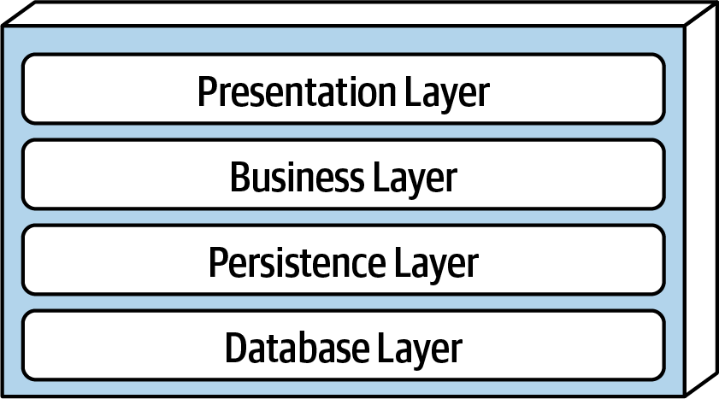
Architecture #1: Layered
Each layer depends on services from the layer or layers below
Organize teams by Layer
different layers require different expertise
When the layers are run on separate pieces of hardware, they are sometimes called "tiers"

Slide 9
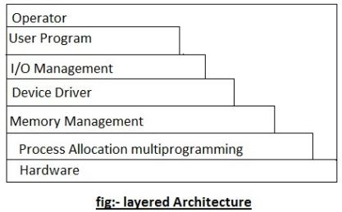
Layered Architecture (contd)
Typical organization for operating systems
Layers communicate through procedure calls and callbacks ("up-calls")
Well-defined interfaces are a must!

Slide 10
Layers from a Spring '21 example
index.ts : contains scripts to be executed.
Calls: getTranscript, getStudentIDs, etc., corresponding to the REST endpoints
dataService.ts: provides REST endpoints
exports: getTranscript, getStudentIDs, etc.
This is the only module that refers to axios. So if we switch to another http package, this is the only file that needs changing
remoteService.ts : provides http methods
exports: remoteGet, remotePost, etc.
axios: an npm package that actually does the http work
provides: axios.get, axios.post, etc

Slide 11
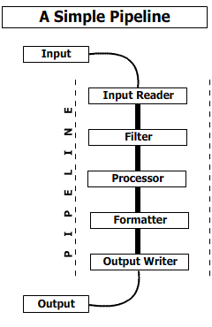
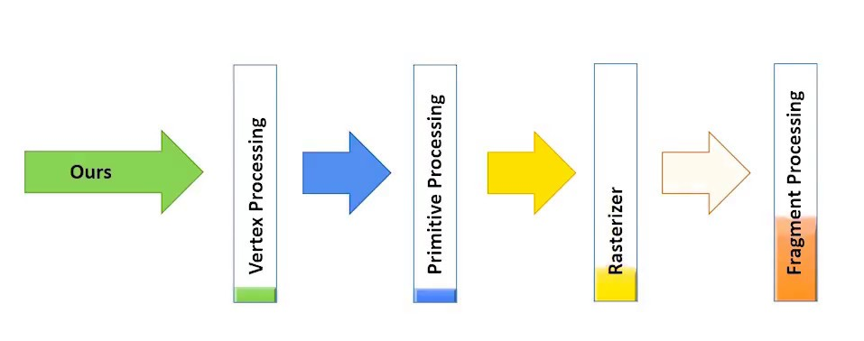
Architecture #2: Pipeline
Good for complex straight-line processes, eg image processing

Slide 12
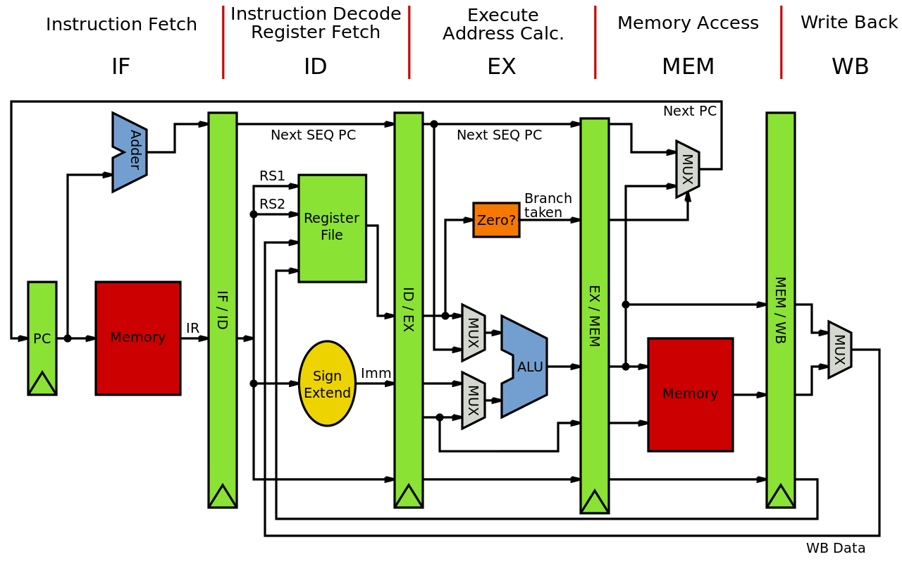
Also good for visualizing hardware

Slide 13
How do the stages communicate?
That's the next-level decision
data-push (each stage invokes the next)
demand-pull (each stage demands data from its predecessor)
queues? buffers?
??

Slide 14
In Express, each stage gets an object that represents the rest of the pipeline
app.use((req, res) => {
res.status(404).json({
error: 'Not Found',
message:
`Route ${req.method} ${req.originalUrl} not found`
});
Notes:
res is an object, calling it with .status(404) causes it to emit a 404 immediately, but there are other possibilities.

Slide 15
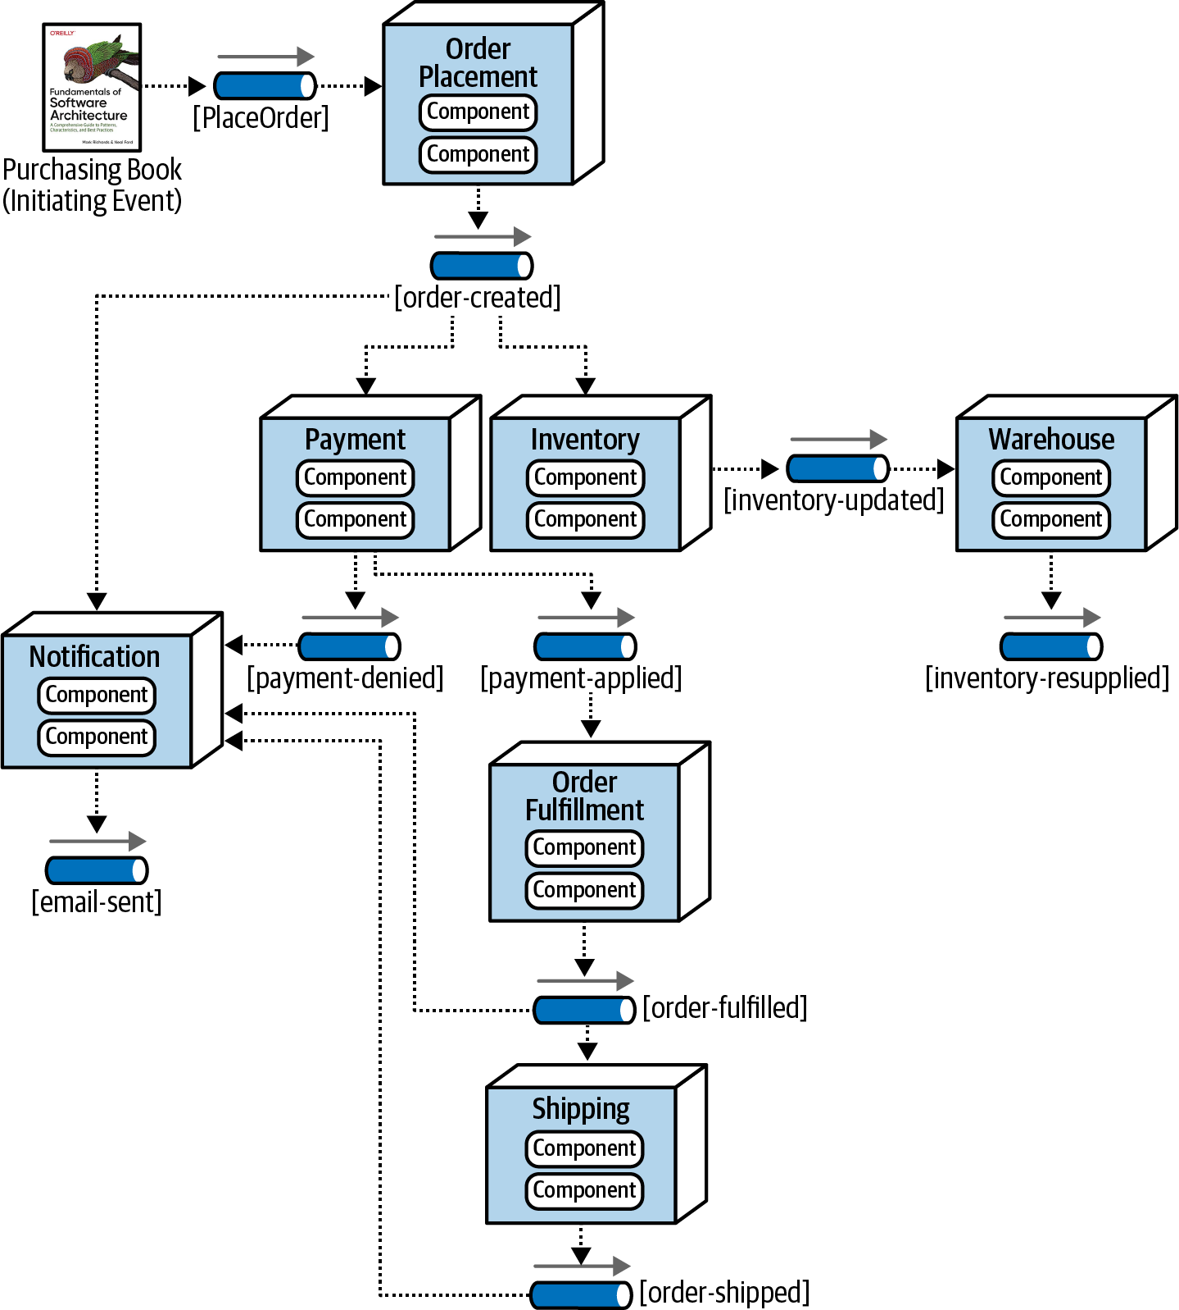
Architecture #3: Event-Driven Architecture
Metaphor: a bunch of bureaucrats shuffling papers
Each processing unit has an in-box and one or more out-boxes
Each unit takes a task from its inbox, processes it, and puts the results in one or more outboxes.
Stages may be connected by asynchronous message queues.
Or use the observer pattern, where each unit observes changes in its upstream units.
Conditional flow

Slide 16
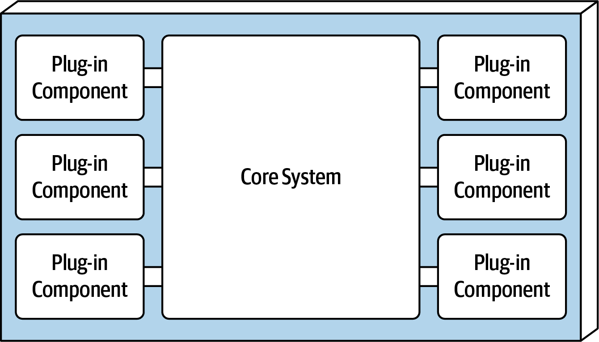
Architecture #4: Plugins ("microkernel")
System consists of a small core (the "microkernel") for essential functions, and lots of hooks for adding other services
Highly extensible
Plug-ins can be designed by small, less-experienced teams– even by users!
Connection methods may vary
often: core provides default behaviors that are overridable

Slide 17
Key Concepts for Plugin Architecture
Activation Events: when does your extension run?
Host API: what procedures in the host app can your extension call?
Contribution Point: what your extension contributes to the host (e.g. new commands, menus, pipeline stages, etc.)

Slide 18
Example 1: git hooks
git provides a fixed set of activation events (files in .git/hooks)
the user can extend git's default behavior by changing these files
$ cat .git/hooks/pre-merge-commit.sample
#!/bin/sh
#
# An example hook script to verify what is about to be committed.
# Called by "git merge" with no arguments. The hook should
# exit with non-zero status after issuing an appropriate message to
# stderr if it wants to stop the merge commit.
#
# To enable this hook, rename this file to "pre-merge-commit".
. git-sh-setup
test -x "$GIT_DIR/hooks/pre-commit" &&
exec "$GIT_DIR/hooks/pre-commit"
:

Slide 19
Example 2: express
export const createApp = (): express.Application => {
const app = express();
// Middleware for parsing JSON requests
app.use(express.json());
// Addition endpoint
app.get('/sum/:i/:j', getSum);
// get the rest of the routes from frontend/dist
app.use(express.static('frontend/dist'));
app.use((req, res) => {
res.status(404).json({
error: 'Not Found',
message: `Route ${req.method} ${req.originalUrl} not found`
});
});

Slide 20
Architecture #5: Microservices
Overall task is divided into different components
Each component is implemented independently
Each component is
independently replaceable,
independently updatable
Components can be built as libraries, but more usually as web services
Services communicate via HTTP, typically REST (see next lesson)

Slide 21
Microservices: Schematic Example
Different languages, different operating systems
NodeJS, MongoDB
Google Service
Java, MySQL
Mod 1
Mod 2
Mod 3
Todos
Logins
Mailer
REST service
REST service
REST service
Productivity App
Database
Database
Database
Frontend
REST
Search Engine
Analytics
Social Crawler
“Dumb”
App Server
Mod 4
Mod 5
Mod 6
REST service
REST service
REST service
Database
Database
Database
Java, Neo4J
C#, SQLServer
Python, MongoDB

Slide 22
Microservice Advantages and Disadvantages
Advantages
services may scale differently, so can be implemented on hardware appropriate for each (how much cpu, memory, disk, etc?). Ditto for software (OS, implementation language, etc.)
services are independent (yay for interfaces!) so can be developed and deployed independently
Disadvantages
service discovery?
should services have some organization, or are they all equals?
overall system complexity

Slide 23
Microservices are (a) highly scalable and (b) trendy
Microservices at Netflix:
100s of microservices
1000s of daily production changes
10,000s of instances
BUT:
only 10s of operations engineers
https://medium.com/refraction-tech-everything/how-netflix-works-the-hugely-simplified-complex-stuff-that-happens-every-time-you-hit-play-3a40c9be254b (2017)

Slide 24
Lesson 10.2: Patterns of Communication
Procedure Calls (with callbacks)
HTTP
REST: a pattern for HTTP
Sockets

Slide 25
1. Procedure Calls
Simplest
Call + Return
Call + Callback
Only really works if both parties are in the same address space
Best suited to layered architecture
Less well-suited to pipeline (e.g. express)

Slide 26
2. HTTP
Client-Server protocol
Client sends a request, Server sends a response
Can be used for Pull pattern
client requests data from server, server responds with data
"GET request"
Can also be used for Push pattern
client sends local data to the server, server responds with acknowledgement
"POST request"

Slide 27
REST is a pattern for using HTTP
Stands for "Representational State Transfer"
Each request contains enough information that a different server could process it
GET requests don't change server state
they are "idempotent"
PUT requests are the ones that update the server state
not idempotent (eg "don't hit the PAY button more than once.")
Uniform Interface - Standard way to specify interface

Slide 28
Uniform Interface: URIs are nouns
In a RESTful system, the server is visualized as a store of named resources (nouns), each of which has some data associated with it.
A URI is a name for such a resource.

Slide 29
Examples
Examples:
/cities/losangeles
/transcripts/00345/graduate (student 00345 has several transcripts in the system; this is the graduate one)
Non-examples:
/getCity/losangeles
/getCitybyID/50654
/Cities.php?id=50654
We prefer plural nouns for toplevel resources, as you see here.
Useful heuristic: if you were keeping this data in a bunch of files, what would the directory structure look like?
But you don't have to actually keep the data in that way.

Slide 30
Path parameters specify portions of the path to the resource
For example, your REST protocol might allow a path like
/transcripts/00345/graduate
In a REST protocol, this API might be described as
/transcripts/:studentid/graduate
:studentid is a path parameter, which is replaced by the value
of the parameter

Slide 31
Query parameters allow named parameters
Examples:
/transcripts/graduate?lastname=covey&firstname=avery
These are typically used to specify more flexible queries, or to embed information about the sender’s state, eg
https://calendar.google.com/calendar/u/0/r/month/2023/2/1?tab=mc&pli=1
This URI combines path parameters for the month and date, and query parameters for the format (tab and pli).

Slide 32
You can also put parameters in the body.
You can put additional parameters or information in the body, using any coding that you like. (We’ll usually use JSON)
You can also put parameters in the headers.
Choose where to put parameters based on readability/copyability:
Path parameters provide a link to a resource
Query parameters modify how that resource is viewed/acted upon
Headers are transparent to users
Body parameters have unrestricted length

Slide 33
Uniform Interface: Verbs are represented as http methods
In REST, there are exactly four things you can do with a resource
POST: requests that the server create a resource with a given value.
GET: requests that the server respond with a representation of the resource
(there are some others, but they are rarely used)

Slide 34
Example interface #1: a todo-list manager
Resource: /todos
GET /todos - get list all of my todo items
POST /todos - create a new todo item (data in body; returns ID number of the new item)
Resource: /todos/:todoItemID
:todoItemID is a path parameter
GET /todos/:todoItemID - fetch a single item by id
PUT /todos/:todoItemID - update a single item (new data in body)
DELETE /todos/:todoItemID - delete a single item

Slide 35
Example interface #2: the transcript database
Remember the heuristic: if you were keeping this data in a bunch of files, what would the directory structure look like?
POST /transcripts
-- adds a new student to the database,
-- returns an ID for this student.
-- requires a body parameter 'name', url-encoded (eg name=avery)
-- Multiple students may have the same name.
GET /transcripts/:ID
-- returns transcript for student with given ID. Fails if no such student
DELETE /transcripts/:ID
-- deletes transcript for student with the given ID, fails if no such student POST /transcripts/:studentID/:courseNumber
-- adds an entry in this student's transcript with given name and course.
-- Requires a body parameter 'grade'.
-- Fails if there is already an entry for this course in the student's transcript
GET /transcripts/:studentID/:courseNumber
-- returns the student's grade in the specified course.
-- Fails if student or course is missing.
GET /studentids?name=string
-- returns list of IDs for student with the given name
Didn't seem to fit the model, sorry

Slide 36
It would be better to have a machine-readable specification
The specification of the transcript API on the last slide is RESTful, but is not machine-readable
A machine-readable specification is useful for:
Automatically generating client and server boilerplate, documentation, examples
Tracking how an API evolves over time
Ensuring that there are no misunderstandings
Notes:
(Read slide)

Slide 37
OpenAPI is a machine-readable specification language for REST
Uses YAML syntax
Not really convenient for human use
Better: use a tool!
/towns/{townID}/viewingArea:
post:
operationId: CreateViewingArea
responses:
'204':
description: No content
'400':
description: Invalid values specified
content:
application/json:
schema:
$ref: '#/components/schemas/InvalidParametersError'
description: Creates a viewing area in a given town
tags:
- towns
security: []
parameters:
- description: ID of the town in which to create the new viewing area
in: path
name: townID
required: true
schema:
type: string
- description: |-
session token of the player making the request, must
match the session token returned when the player joined the town
in: header
name: X-Session-Token
required: true
schema:
type: string
requestBody:
description: The new viewing area to create
required: true
content:
application/json:
schema:
$ref: '#/components/schemas/ViewingArea'
description: The new viewing area to create
Notes:
(Read lefthand side of slide)
The code on the right is a snippet of the OpenAPI specification for the Create Viewing Area method of the TownService API. We do not expect you to be able to read or write these specifications directly. Instead, we ‘ll use tools…

Slide 38
Tools for making these protocols machine-readable
TSOA
reads an annotated controller file
but only works with particular controller structures
Swagger
human-annotated controller and route files
generates nice docs
but still requires human attention to ensure consistency, validation

Slide 39
Swagger example (in a routes file)
/**
* @swagger
* /authors/{id}:
* put:
* summary: Update an author
* tags: [Authors]
* parameters:
* - in: path
* name: id
* required: true
* schema:
* type: string
======= many lines omitted ======
* responses:
* 200:
* description: Author updated successfully
* content:
* application/json:
* schema:
* $ref: '#/components/schemas/Author'
* 404:
* description: Author not found
*/
router.put('/:id', updateAuthorById);
Detailed description of the request, in YAML, human-written

Slide 40
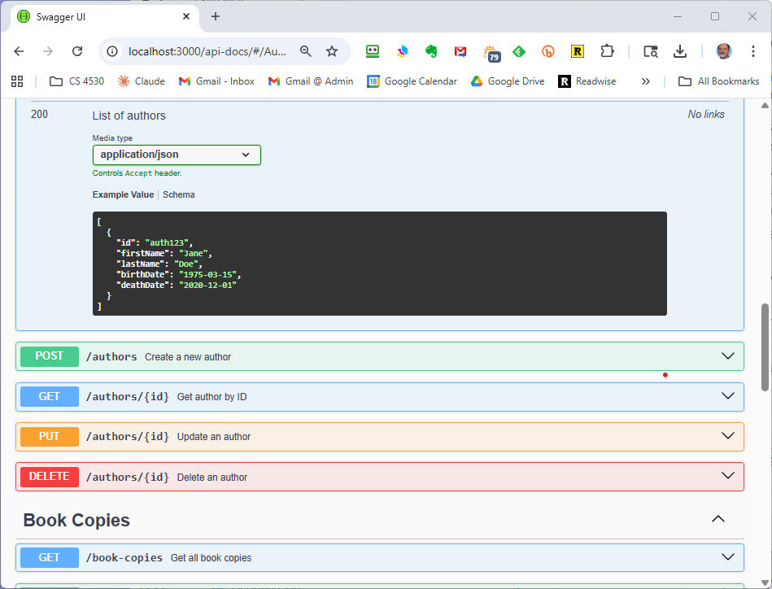
Swagger-generated documentation
Can also run queries right from this page!

Slide 41
But we'd like to do better
No guarantee the human-written descriptions are accurate!
Correct extraction of data from a request?
Automatic validation?
There are tools for this, too
swagger-codegen
OpenAPI Generator
…and others

Slide 42
3. Websockets
Server-Client
We saw this earlier in Module 05.
Client talks only to server
Server can talk to a single client or to subsets of the clients
Either side can initiate a conversation
Allows for more complex protocols
like we saw in Module05
NOT query-response
though a particular protocol may do some of this
But generally less scalable than HTTP.

Slide 43
Review
You should now be able to:
describe the basic ideas of the following architectures, with examples and pictures
anarchic
layered
pipeline
event-driven
microkernel
microservice
describe the main features of the following communication modalities:
procedure calls
HTTP and REST
Websockets

